Slide 1
FINANCIAL MARKET PREDICTION IN AI
Created by
VISHWA M
REG.NO : 912321104053
IIIrd year CSE
SACS M.A.V.M.M ENGINEERING COLLEGE

Slide 2
PROJECT OUTLINE
Problem statement
Proposed system /solution
System development approach
Algorithm and deployment
Result
Conclusion
Reference

Slide 3
PROBLEM STATEMENT
This project focuses on utilizing AI techniques for predicting financial market trends. By analyzing vast datasets encompassing historical market behavior, machine learning algorithms generate predictive models to forecast future trends. The aim is to empower investors with valuable insights, aiding decision-making processes in volatile financial environments.

Slide 4
PROPOSED SYSTEM / SOLUTION
In my financial market prediction project, two vital techniques utilized are machine learning algorithms and deep learning.
Machine learning algorithms analyze historical financial data to discern patterns and relationships, facilitating tasks like stock price forecasting and risk management.
Deep learning, particularly with recurrent neural networks (RNNs) and long short-term memory (LSTM) networks, excels in capturing intricate temporal dependencies in financial time series, aiding in tasks such as high-frequency trading and market trend analysis.

Slide 5
SYSTEM DEVELOPMENT APPROACH
SYSTEM REQUIREMENT
HARDWARE REQUIREMENT :
Processor: A multi-core processor (CPU) or a graphics processing unit (GPU) with sufficient computational power for training complex machine learning models efficiently.
Memory (RAM): Adequate RAM to handle large datasets and computational tasks effectively. Typically, a minimum of 8GB RAM is recommended, though higher capacity is preferable for more extensive datasets and model training.
Storage: Sufficient storage space to store historical financial data and model artifacts. Solid-state drives (SSDs) are preferred for faster data access and model training.

Slide 6
SOFTWARE REQUIREMENTS :
Python: Python serves as the primary language for AI projects due to its rich ecosystem of libraries and frameworks.
TensorFlow / PyTorch: Libraries such as TensorFlow, PyTorch, and scikit-learn are utilized for building and training AI models, while Pandas facilitates data manipulation tasks.
Visualization Tools: Matplotlib, Seaborn, or Plotly are employed for visualizing financial data and interpreting model results.
PyCharm & VSCode: integrated development environments (IDEs) like PyCharm and VSCode provide suitable environments for coding, experimentation, and collaboration within the financial prediction project.

Slide 7
ALGORITHM AND DEPLOYMENT
Deep Learning with LSTM: Utilized LSTM (Long Short-Term Memory) neural networks for financial time series prediction due to their ability to capture complex temporal patterns and dependencies in the data.
Machine Learning Ensemble: Employ a machine learning ensemble approach, combining multiple algorithms such as random forests, gradient boosting machines (GBM), and support vector machines (SVM) to leverage their complementary strengths in financial prediction tasks.
Gradient Boosting Trees: Employ gradient boosting algorithms such as XGBoost or LightGBM for financial market prediction tasks due to their ability to handle complex data relationships and nonlinear patterns effectively.

Slide 8
Model Training and Validation: Trained the LSTM model on historical financial data, validating performance using metrics such as Mean Absolute Error (MAE) and Root Mean Squared Error (RMSE) to ensure accuracy.
Model Deployment: Deployed the trained LSTM model into a production environment, integrating it into the financial market prediction system or application infrastructure.
API Development: Developed an API endpoint to expose the model, allowing real-time market prediction requests from users or other systems.
Scalability and Performance: Ensured scalability and optimized performance of the deployed model, leveraging cloud computing resources if necessary to handle increased prediction demand efficiently.
Monitoring and Maintenance: Implemented monitoring mechanisms to track model performance, detect drift or degradation, and continuously update and retrain the model with new data to maintain accuracy and relevance in dynamic financial markets.

Slide 9
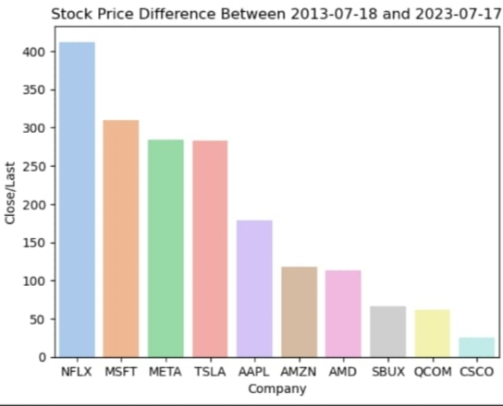
RESULT
Stock Price Difference Rank Over 10 Years

Slide 10
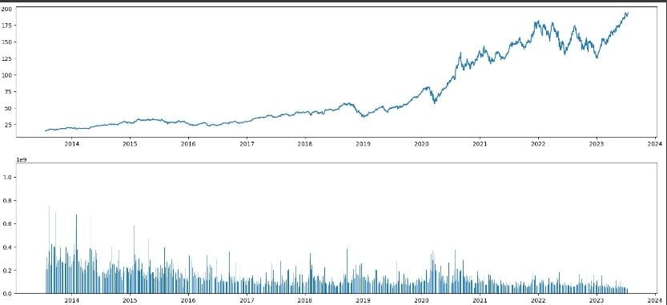
Stock Volume Analysis

Slide 11
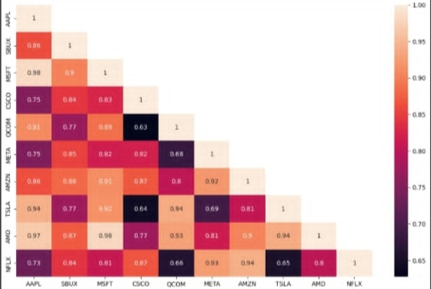
Correlation Analysis

Slide 12
REFERENCE
https://www.ibm.com/topics/deep-learning
https://www.ibm.com/topics/machine-learning
https://www.kaggle.com/
https://colab.research.google.com/?utm_source=scs-index
https://www.geeksforgeeks.org/deep-learning-introduction-to-long-short-term-memory/

Slide 13
CONCLUSION
The AI-driven financial market prediction project has successfully developed robust models to forecast market trends and asset prices. Leveraging advanced machine learning techniques, we aim to provide actionable insights for investors and traders, empowering them to make informed decisions in volatile financial markets. With a focus on accuracy and adaptability, our project contributes to enhancing risk management strategies and optimizing investment portfolios in the dynamic landscape of finance.

Slide 14
THANK YOU

